Slide 1
Is it time to invest in our public transportation system?
A look into how Nashville compares with its peers.

Slide 2
Goals
To evaluate if Nashville needs to invest more into public transportation.
Compare Nashville to some of its peers.
A view into what Nashville could look like in the future.

Slide 3
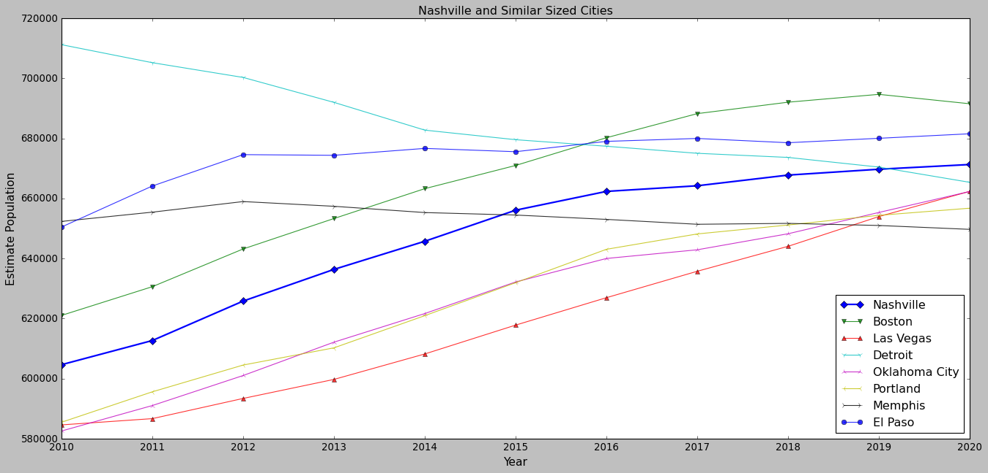
Similar Sized Cities to Nashville

Slide 4
Benefits of public transportation
Public transportation reduces air pollution
Increases mobility
Encourages healthier habits
Reduced traffic congestion

Slide 5
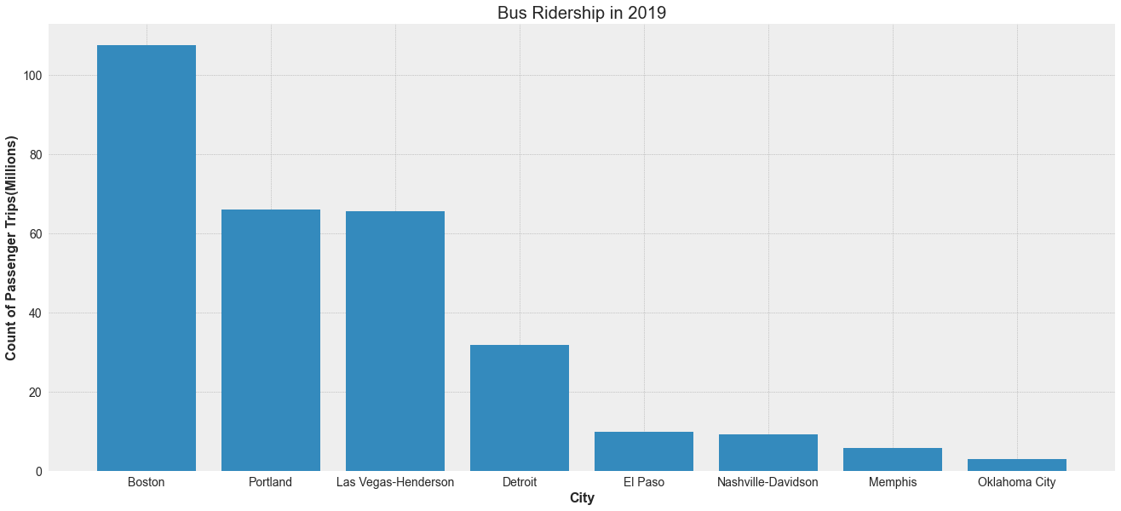
Looking at the most common mode of public transportation.

Slide 6
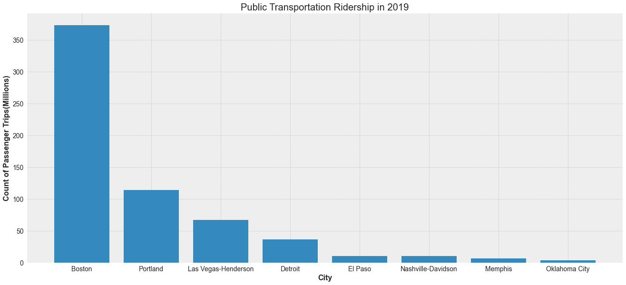
Total Ridership 2019

Slide 7
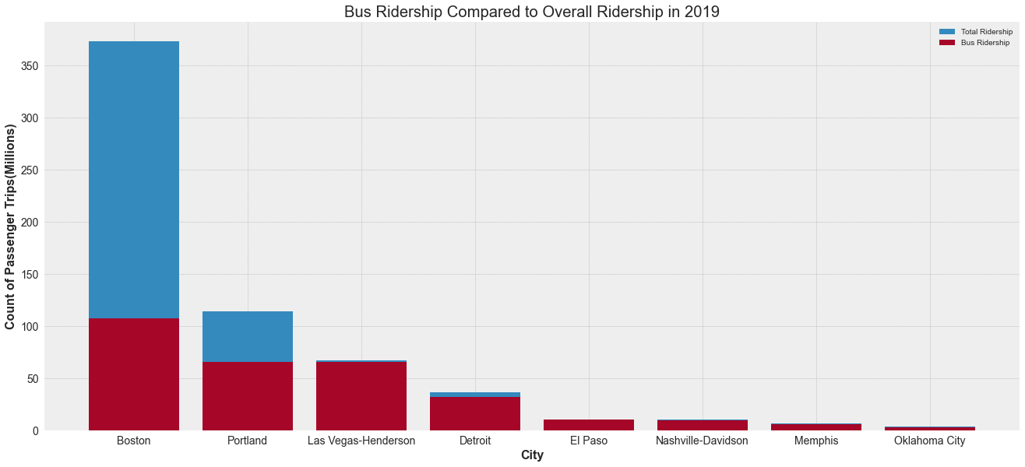
Bus Ridership vs Overall

Slide 8
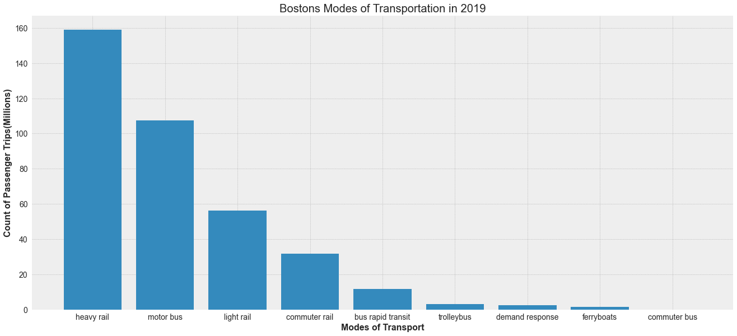
Boston’s Modes of Transportation

Slide 9
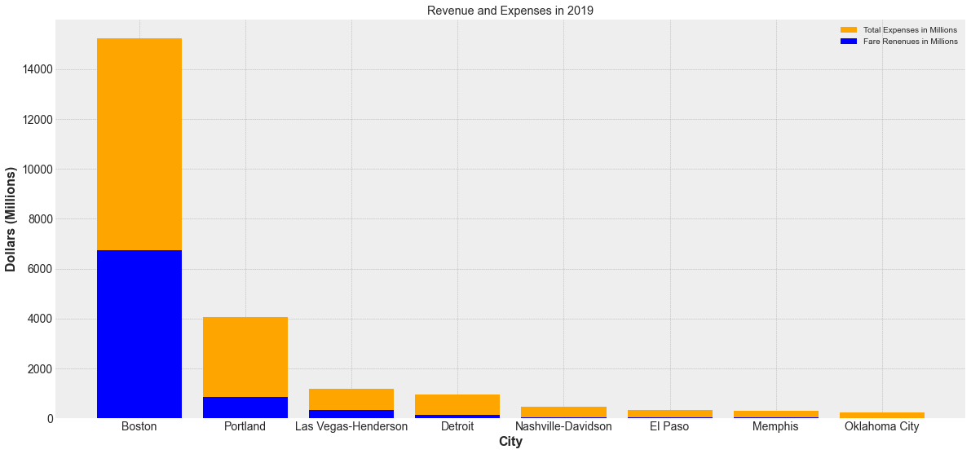
Revenue and Cost Breakdown

Slide 10
